Slide 1
Program Input

Slide 2
Making your programs interactive
At this point, your programs have no way of interacting with the user – they will always run with the statements and values listed in the source code
“Real” programs allow the user to affect how they run based on user input as the program is running
Example:
In a computer game (which is really just a very complex program), you might press a certain key to make your character move forward. A different key would make him/her move backward. Your key presses are inputs!
Imagine if every time you wanted to move forward instead of backward, you had to modify a value in the source code and run the entire thing again

Slide 3
Python’s input() command
The input() command allows a program to pause, wait for the user to type in something, then read the value that s/he just typed in
You can store the user input into a variable, then use this value at a later point in the program
This means your program can give different results based on what you typed in – your input affects how the program runs!
If you include a string between the parentheses of input(), Python will print that string before waiting for user input

Slide 4
A simple example of input()
# ask the user to enter his/her name, and store the
# input into the variable name
name = input("What is your name? ")
# do something similar for the variable quest
quest = input("What is your quest? ")
# display a personalized message based on what was
# typed in
print("Hello, " + name + ". I wish you the best of luck on " + quest + "!")

Slide 5
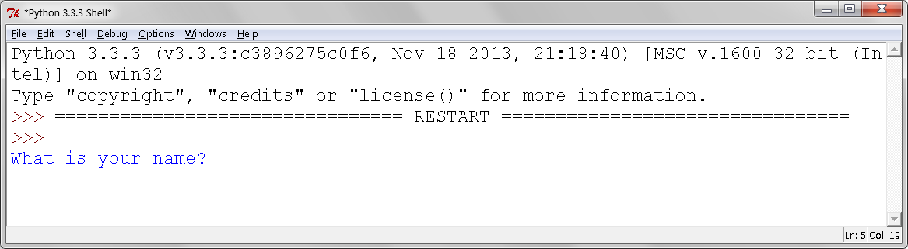
A simple example of input()
Here’s what you see when you first run the program:
The program is pausing and waiting for your input! Type your name and press Enter to proceed.

Slide 6
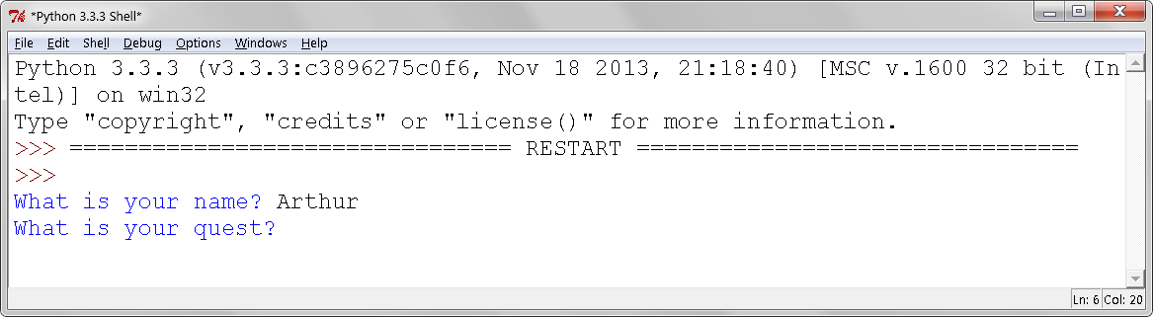
A simple example of input()
The program now advances to the second input() command:
Again, the program is pausing and waiting for your input! Type a quest and press Enter to proceed.

Slide 7
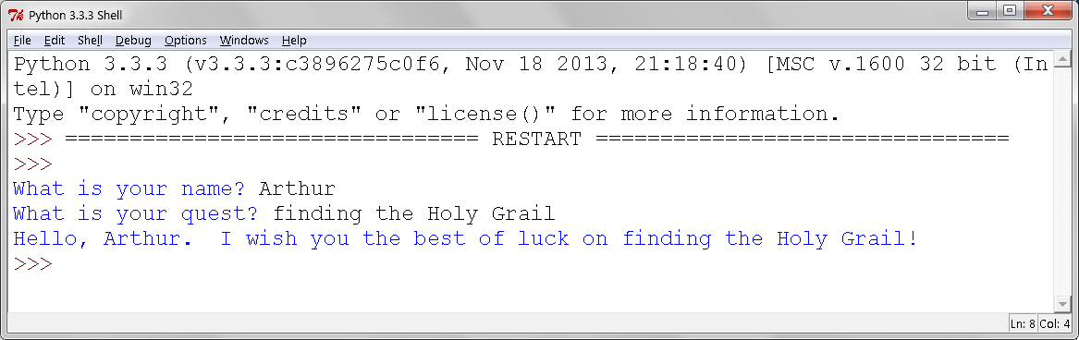
A simple example of input()
Finally, the program runs the last print statement and ends:

Slide 8
input() always reads strings!
Whatever you read using input() is always treated as the str (string) data type
This has serious implications when your program tries to read numbers from the user
Example: suppose you want to write a simple “calculator” program that will allow the user to enter two numbers, then find their sum

Slide 9
Calculator, version 1
# get user input for the two numbers, storing it in the
# variables num1 and num2
num1 = input("Enter the first number: ")
num2 = input("Enter the second number: ")
# add the two numbers, and store the result in the
# variable ans
ans = num1 + num2
# show the result
print("The sum is: " + ans)
Try running this program and entering the values 1 and 2. You should see the output The sum is: 12 Why does this happen?

Slide 10
Calculator, version 2
# get user input for the two numbers, storing it in the
# variables num1 and num2
num1 = float(input("Enter the first number: "))
num2 = float(input("Enter the second number: "))
# add the two numbers, and store the result in the
# variable ans
ans = num1 + num2
# show the result
print("The sum is: " + str(ans))
The float around the input() tells Python to treat what it reads as float values rather than strings. (You can also do the same thing for int.)
Why did we have to add str() around the variable ans in the last print statement?

Slide 11
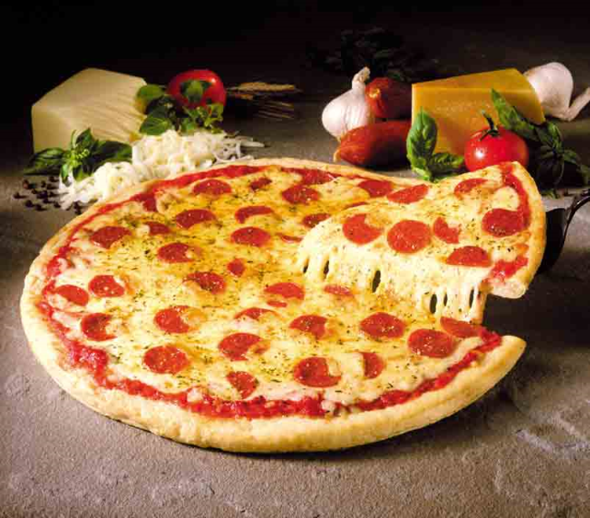
A more complex example
Suppose you’re working for an old-fashioned pizzeria that wants to modernize its ordering system. Your boss wants a program that allows the user to enter information about an order and then automatically calculates the total cost
Pizzas cost $15 each
Side items cost $4 each
Beverages cost $1.50 each
The Memphis sales tax (9.25%) should be added to the total order cost
Hungry yet? ...

Slide 12
A more complex example
Don’t panic! Start by thinking about what information the program needs to calculate the order cost
Price of each item. You already have that info!
Quantity of each item that the customer wants to buy. You don’t know this until the order is actually entered, so let’s have the program read this information from the user using input(), and store it into variables.

Slide 13
A more complex example
Once you know the price and quantity of each item, how do you compute the before-tax subtotal? (Number of pizzas) * (Price per pizza) + (Number of side items) * (Price per side) + (Number of beverages) * (Price per beverage)
Once you know the subtotal, how do you compute the amount of tax? (Subtotal amount) * 0.0925
Once you know the amount of tax, how do you compute the final total? (Subtotal amount) + (Amount of tax)

Slide 14
A more complex example
Putting it all together: Your Python program needs to take these actions in this order:
Read user input for quantities of each item, and store it into variables
Calculate and display the order subtotal
Calculate and display the amount of tax
Calculate and display the final total
See the source code posted on eCourseware for the full program

